Slide 1
Nortcele Systems
Presents
E-Commerce Online Store

Slide 2
Contents
1 | Executive Summary
2 | What we do
3 | Introduction of HMS
4 | What we can do with HMS
5

Slide 3
Executive Summary
Founded in 2020
India, Bangalore
25+ Employees
11 Clients
To Engage with mid size or start-ups companies and augment their team to bridge skill gaps to realize their goal economically and timely.
The Terms ‘Fail Fast’, ‘Fail Often’ and ‘ Fail Better’ are quite applicable in the context of start-ups.
Nortcele endeavors to transform these slogans to ‘Succeed Fast’, ‘Succeed Better’ and Succeed Often’.
Our team consists of veterans in the field of tech with decades of experience in building products related to Embedded Systems, Telecommunication, Data communication., Storage and Automotive,.
It has been observed that hiring experts(SMEs) is difficult to afford for a start-up. Our aim is to provide an economical solution to bridge this gap in technical expertise.
Nortcele aims to help start-ups that are engaged in building hardware and software products.
We have expertise in realizing products from ideation, prototyping to productization.
We understand the constraints one faces during the bootstrapping of a start-up companies.
We are your real partners
Silicon Design Services
Board Design & Board Bring up
FPGA, Emulation & DSP
Embedded Design Services
Firmware, BSP, Boot Loader, wireless Mobile device, IoT devices, Device Drivers, Platform Dev Android /Linux/ Windows Application Development/Testing
Full Stack Development
UI/UX, Mobile App Development (iOS & Android)

Slide 4
What We Do - Nortcele
Full Stack Dev
Ui/UX,
Mobile App Dev (iOS & Android App)
IoT Device,
Automation
Firmware, Security Cloud Interface
Mobile Devices
-3GPP
- SDK, NDK, Drivers & Phone development,GCF,PTCRB & other certifications
Connectivity
BT/BLE–Profile development, Host Stack Integration & Testing
WLAN – Host bring up & testing.
LBS support
Storage
Protocols(SATA,NVMe & UFS).Feature enhancement, Automation testing
Embedded System & Software
Product (RE)Engineering
Verification & Validation

Slide 5
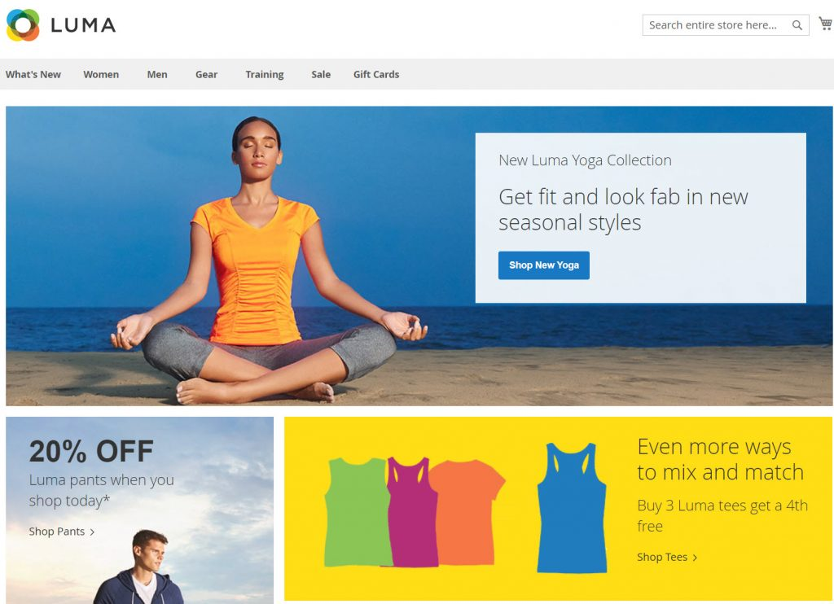
E-Commerce Online Store - Frontend

Slide 6
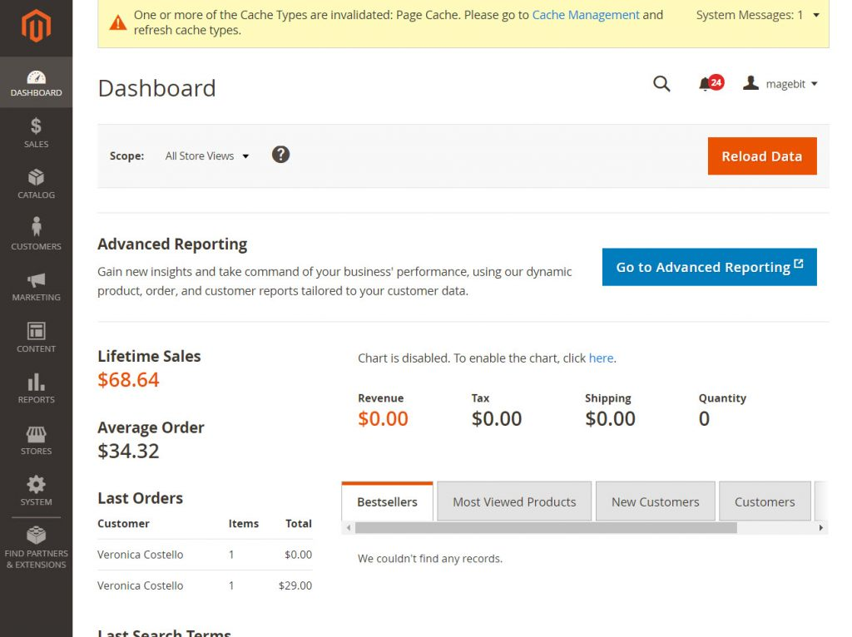
E-Commerce Online Store - Admin

Slide 7
Frontend Element
Homepage
Category page
Product detail page
Cart page
Checkout Page
Account login/ Account creation page
Other static page

Slide 8
Homepage
Homepage is your store’s portal page, it includes links to all other part of your websites.

Slide 9
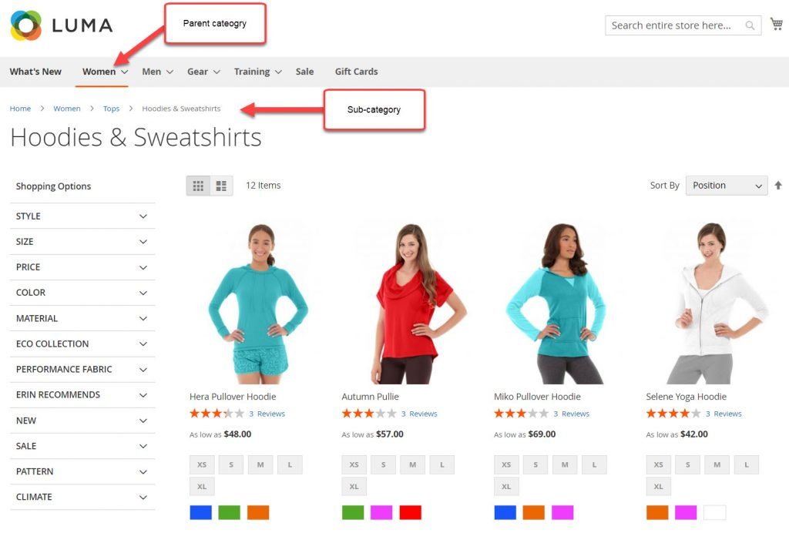
Category page
Category page groups similar products defined by admin. For example, Women category include all products for woman, Hoodies & Sweatshirts category includes hoodies and sweatshirts. Category can have Subcategory, Subcategories enable you to further structure products, for example: Woman (category) > Woman hoodie (subcategory)

Slide 10
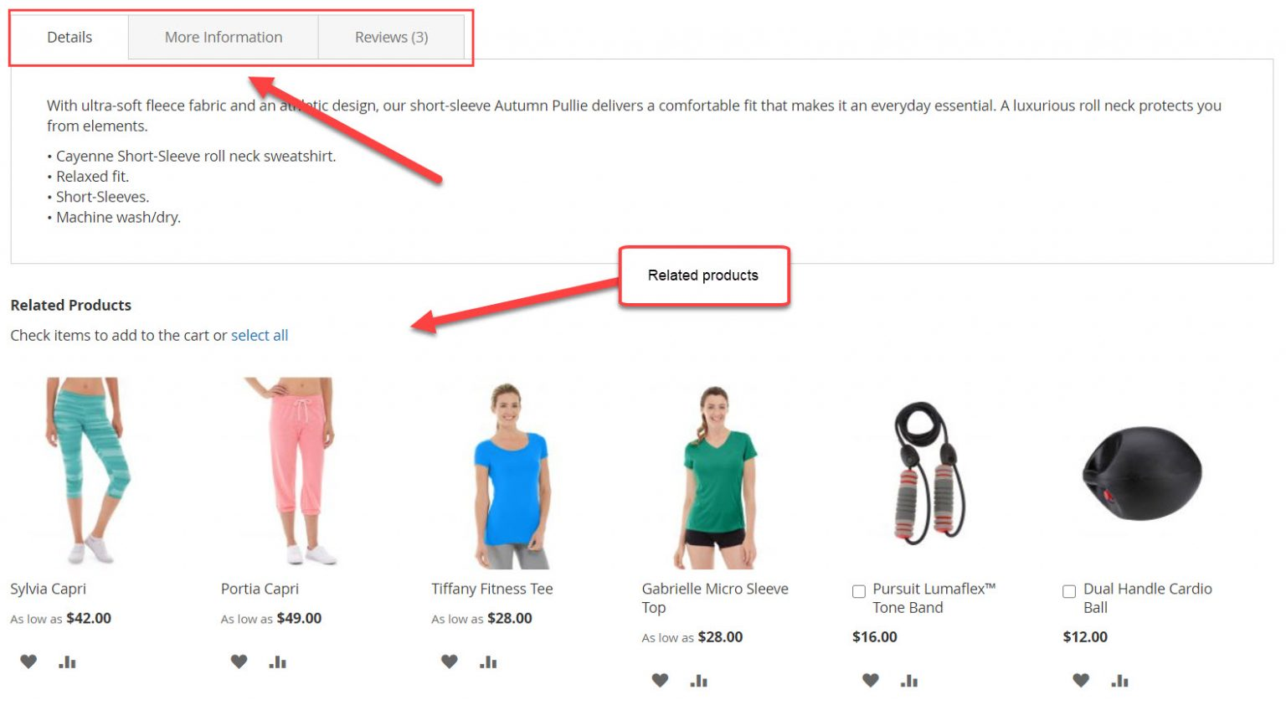
Product detail page
The second part of a product details page is product description, reviews, warranty … You can add more tab according to your requirement. Under product detail section, shows related products. Related product are product that are similar with the product customer are viewing (you can set the rule for related product). For example, related products are product of the same category, or product in a same price range….

Slide 11
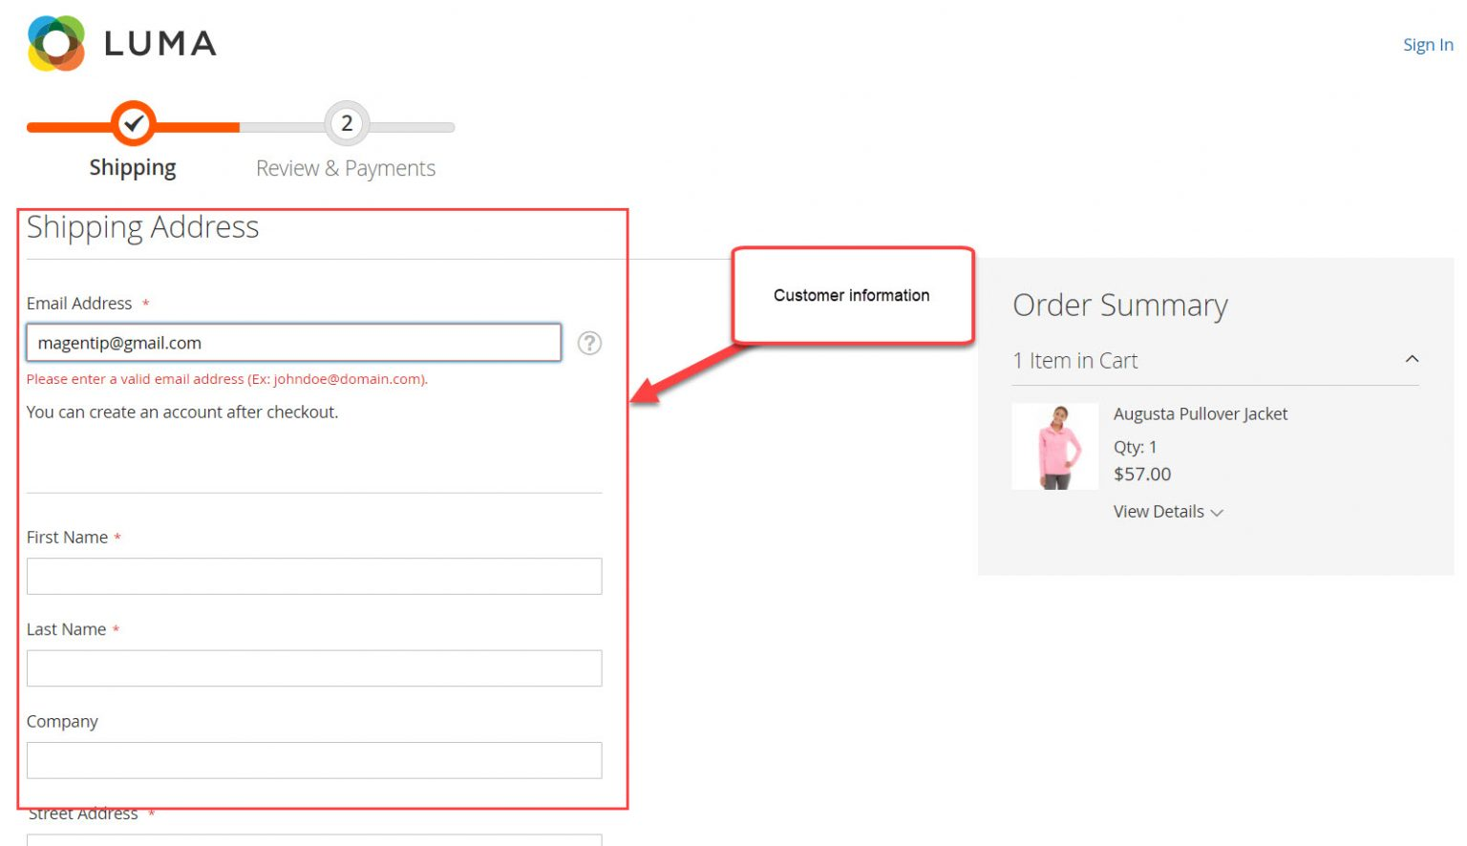
Checkout page
After a customer add products to cart, to finish order, they will be redirected to checkout page. This is where the customer fills in necessary information to finish his order

Slide 12





Location #92, Ist Floor, Natraj building, Near SNS Arcade, Konnena , Old Airport Road, Bangalore 560017 www.nortcele.in Contacts
Contact us
Nortcele Systems
+91 9886422528
aks@nortcele.in
www.nortcele.in

Slide 13
Thank You

